Slide 1


Strategic &
Competitive Intelligence
Università di Pisa Project work 2020-2021
Artificial Intelligence & Defence
Team
Alessandro Bonini
Carlo Alberto Carrucciu
Gian Maria Pandolfi
Teachers
Antonella Martini
Filippo Chiarello

Slide 2



OUR TEAM
Carlo Alberto Carrucciu
Alessandro Bonini
Gian Maria Pandolfi
Background:
Management Engineering
Background:
Economics
Background:
Computer Engineering

Slide 3
RACI
MATRIX
 | WEB SCRAPING | TOPIC MODELING | NETWORK ANALYSIS | TREND ANALYSIS
 | Responsible | Consulted | Responsible | Responsible
 | Responsible | Responsible | Consulted | Responsible
 | Informed | Consulted | Consulted | Accountable

Slide 4
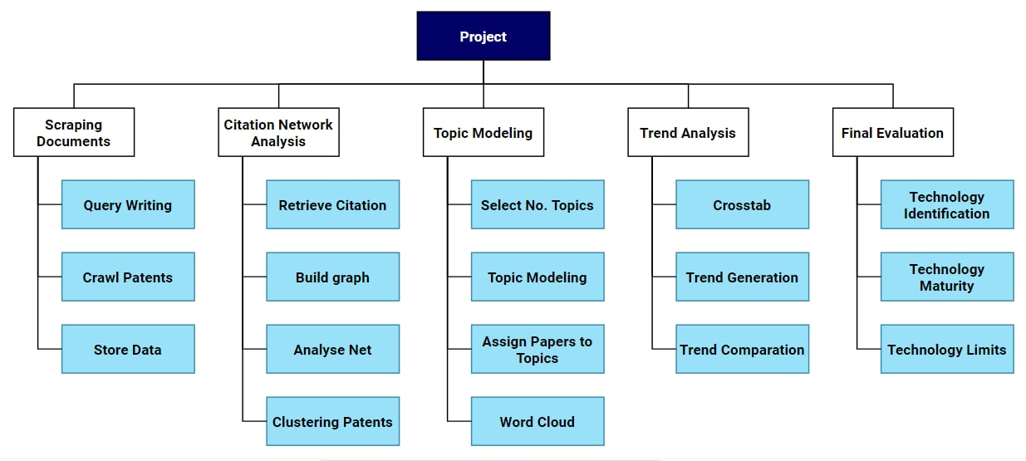
Work Breakdown Structure

Slide 5
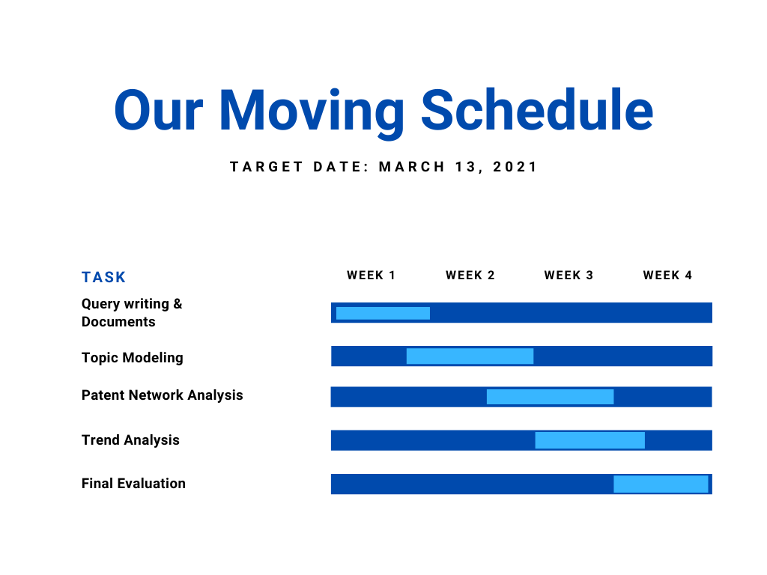

Slide 6
Abstract
Our research links artificial intelligence with its applications in the defence topic
Methodologies have been developed in order to find new key technologies and also answers the Asset+ challenge promoted by EU, for which we have been selected.
The analysis started with web crawling and scraping on Scopus to collect scientific articles. Then using our query we scraped Google Patents to collect the patents.
We applied text cleaning on the abstracts collected in order to prepare our dataset for the topic modelling.
Once we’ve collected the topics we did a trend analysis and we applied network analysis algorithms to each of the topic in order to understand which are the documents with most relevance. So, we discovered new trend technologies and technologies which are reaching the maturity.

Slide 7
ARTIFICIAL INTELLIGENCE
DEFENCE

Slide 8


Context
The European Commission has declared technology as the EU’s top priority for the next five years.
More particularly, one key objective is the mastery and ownership of key technologies in Europe.
With this objective in mind we decided to analyze the patent and scientific articles landscape in order to evaluate the most important technologies for Europe’s sovereignty in defence and security.

Slide 9

Which technologies and technology bricks
are particularly relevant for Europe’s
sovereignty in defence and security?

Slide 10
01
02
04
Agenda
03
Text Cleaning &
Topic Modeling
Query Formulation
Data Retrieval
Trend Analysis &
Network Analysis
Top Technologies Selection

Slide 11

Our Query!
("artificial intelligence" OR "machine learning" OR "image recognition" OR "natural language processing" OR "neural networks" OR "big data" OR "optical recognition system" OR "synthetic intelligence" OR "speech recognition" OR "machine vision" OR "dialogue system" OR "machine translation" OR "pattern recognition" OR "autonomous vehicle" OR "machine perception")
AND
( “cyber defence” OR “cyberdefence” OR "election" OR "fake news" OR "malware" OR "terrorism" OR "hacking" OR "sabotage" OR "propaganda" OR "misinformation" OR "disinformation" OR "espionage")
We tried to focus our research on the opportunities that the artificial intelligence can bring and the dangers misinformation can leads to…

Slide 12


1. Retrieve Information
STEP 3
STEP 2
STEP 1
Data Cleaning and Data Preparation
Documents Collection and Data Structuring
Querying Scopus and Google to get scientific articles and patents

Slide 13








Slide 14
DATASET STRUCTURE
code
title
pub_date
citations
abstract
class
US8370262B2
System and ...
2013-02-05
US10681025B2, ...
The System and ...
G06
.
.
.
.
.
.
.
.
.
.
.
.
.
.
.
.
.
.
.
.
.
.
.
.

Slide 15
Cleaning your data is important
!
Abstract
Citations
A small part of the patents was without abstract, and have been deleted. Abstracts are fundamental for our analysis
Only the records that had at least one internal citation have been condìsdiered

Slide 16
22,573
7,981
17,457
Patents retrieved from Google Patents
Scientific Papers retrieved from Scopus
Number of Documents after Data Cleaning

Slide 17
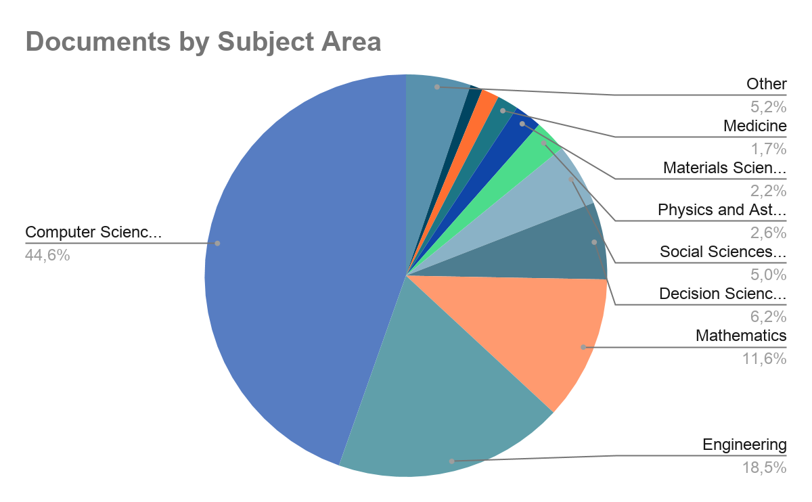
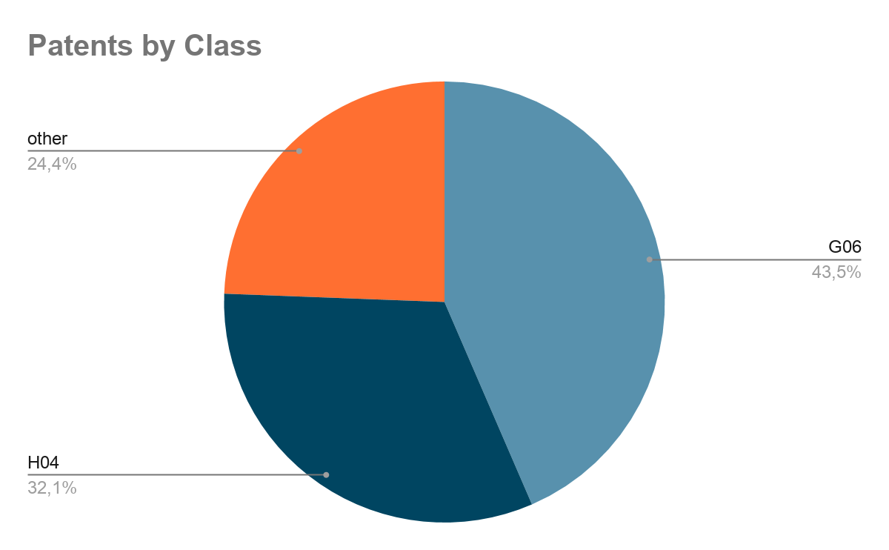
Documents Analysis
G06 - COMPUTING; CALCULATING; COUNTING
H04 - ELECTRIC COMMUNICATION TECHNIQUE

Slide 18
2. Topic modeling
STEP 3
STEP 2
STEP 1
Topic Analysis
and Understanding
Topic Modelling
Abstract Collection
and Preprocessing

Slide 19
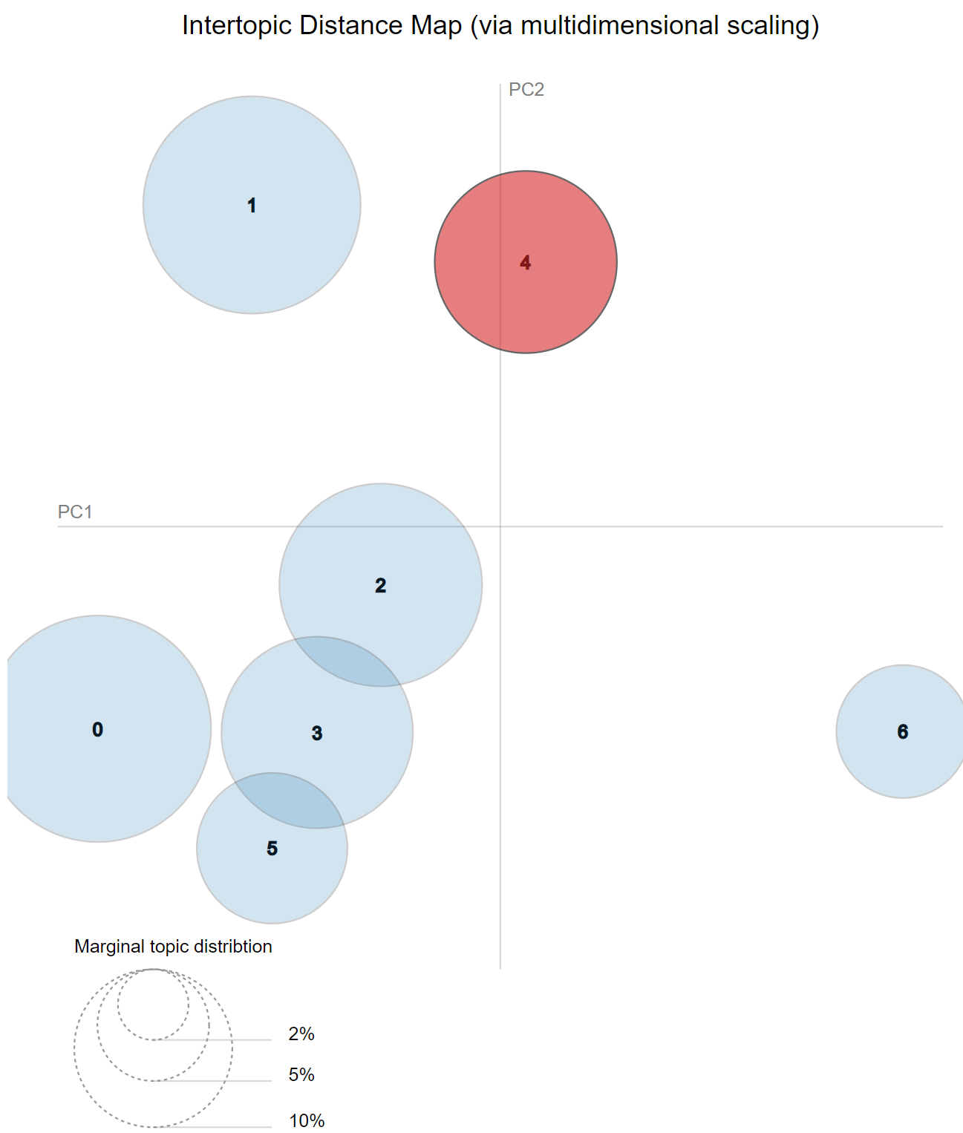



pyLDAvis

Slide 20
Basic passages for text cleaning?
01
02
03
Cleaning text to obtain optimal result during the next phase
Remove punctuation and case normalization
Tokenization
and stopword removing
Lemmatization and
bigram costrupting

Slide 21
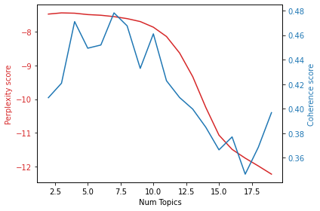
Optimal
No. topics
Analysing perplexity and coherence for different numbers of topics, we discovered that optimal results are reached using 4 or 7 topics

Slide 22
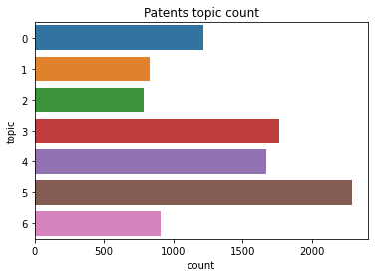
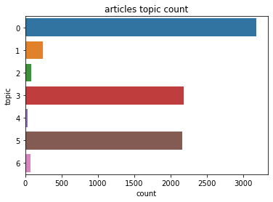
Topics structure

Slide 23
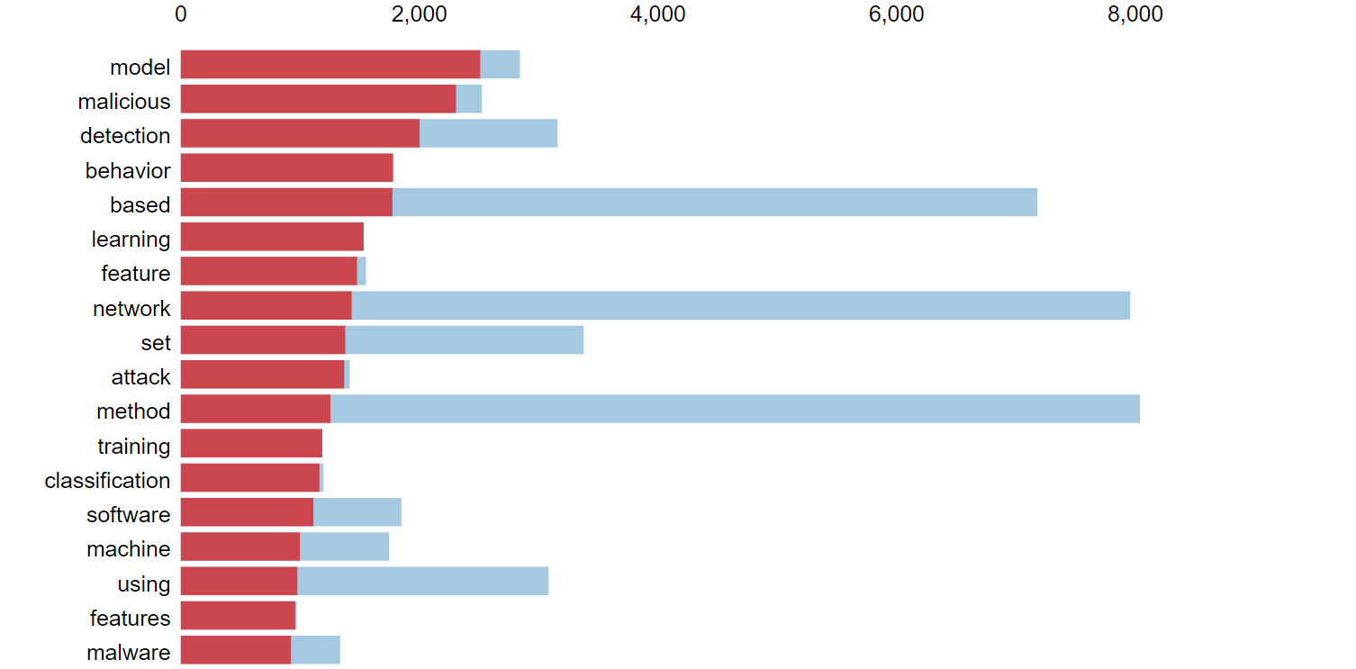
Topic Analysis
Topic Dashboard

Slide 24
Topic Understanding
TOPIC 0
Cyber Security
security, server risk, blockchain cloud, transaction,...
TOPIC 1 Image - Video
image, recognition, camera, face, picture,...
TOPIC 2 User Authentication
system, user, sensors, engine, processor,
controller, ...
TOPIC 6 Not Relevant
first, second, message, document, dns, der, und, die
TOPIC 3 Computer science
file, computing, computer, application, executable, systems
TOPIC 4
Machine learning
model, learning, training, vector, neural, classifier, clustering, sequences
TOPIC 5 Social - Web
social,website,webpage, audio, advertisement, online, search, page

Slide 25
3. Network analysis &
Trend analysis
Components
Trends
Topics
STEP 4
STEP 2 (a)
Community
Detection
Cores Documents Detection
STEP 1
STEP 2 (b)
STEP 3
Component Analysis
Communities
Topic Behavioural Analysis
Trend Analysis
Cores

Slide 26






Slide 27
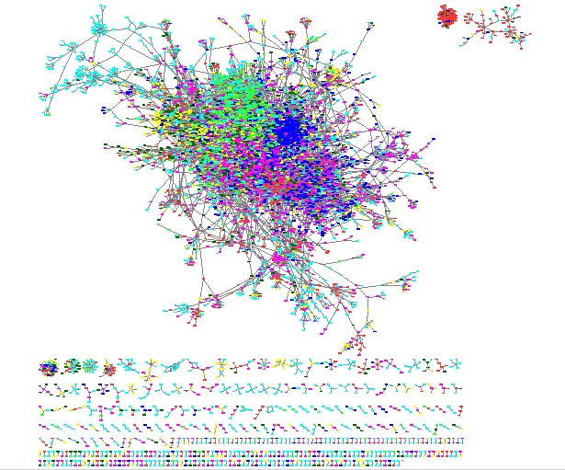
Components :
network is unconnected…
01
02
385
Giant Component
Only one big component of 1084 nodes
Medium size agglomerates
Interesting separated groups, any high clustered
Outliers
Unconnected group of nodes that are not considered

Slide 28
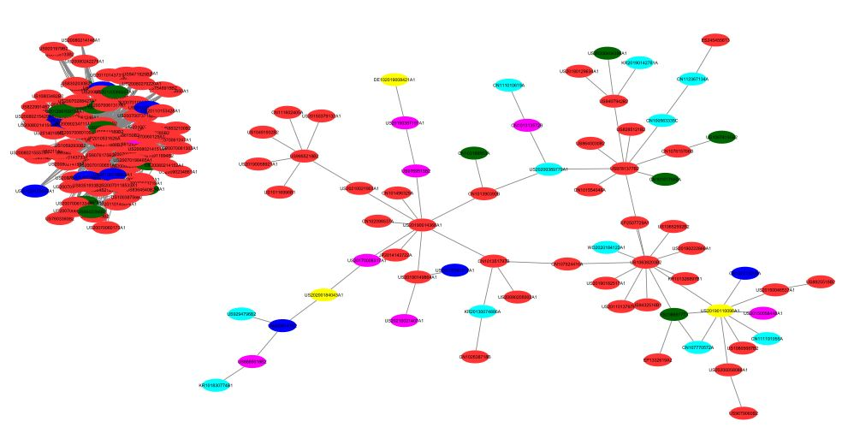
What about the two components of medium size?
120 nodes
High clustering coeff.
68 nodes
Various topics
Mobile
Content
Communication
Search
Content
System
Video
Media

Slide 29
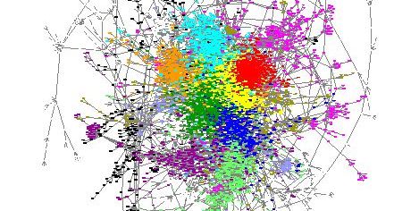
Analysing the giant component!

Slide 30
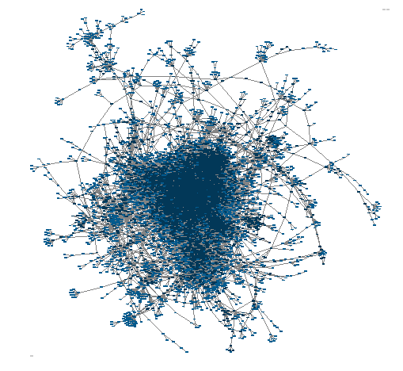
Cores
Structure
More central nodes have an high “core score” according to the core algorithm… 15 concentric cores sections are obtained

Slide 31
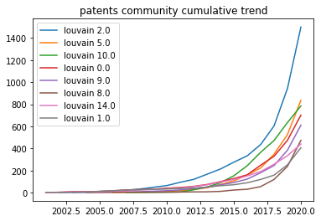
Communities
Detection
Topics do not create any clusters because they are not well separated. So, we can divide the network in clustered Louvain communities.

Slide 32
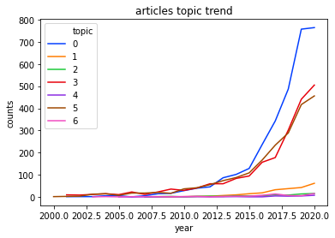
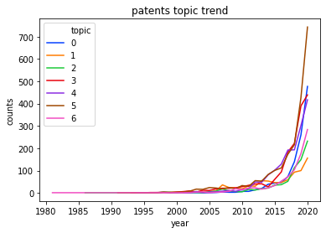
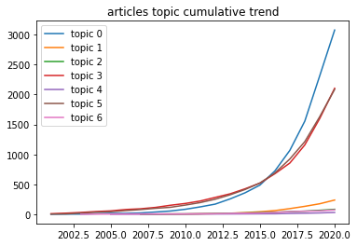
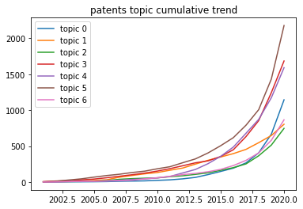
Trend Analysis

Slide 33
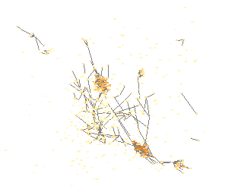
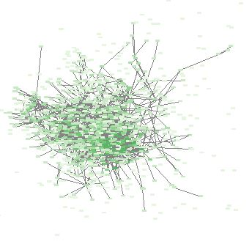
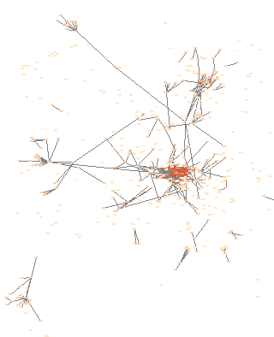
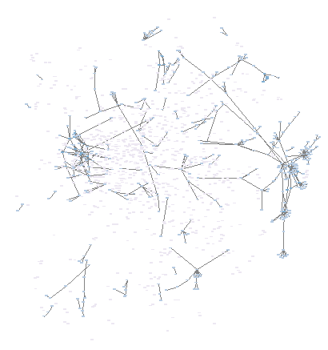
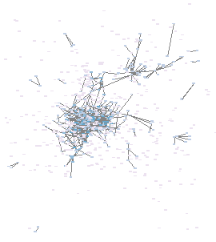
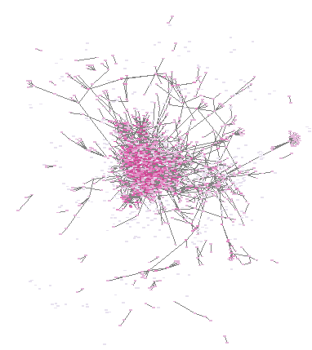
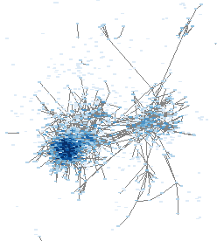
Each topic has a core...

Slide 34
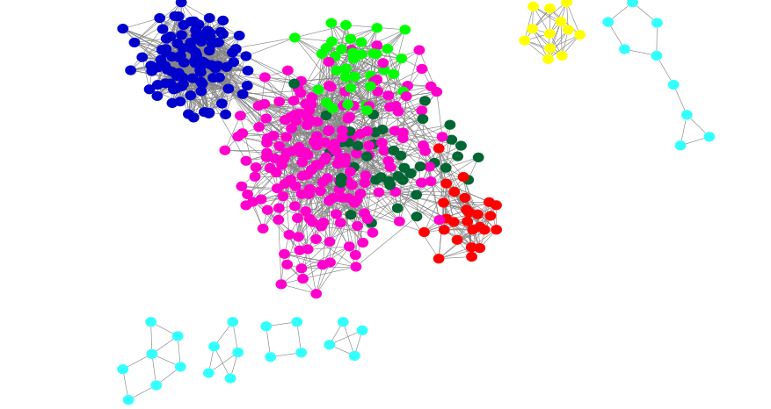
Topics Cores
Detection
Taking in consideration only the cores of each topics, they appear well separated. We will focus on these patents.
Surf the network !

Slide 35
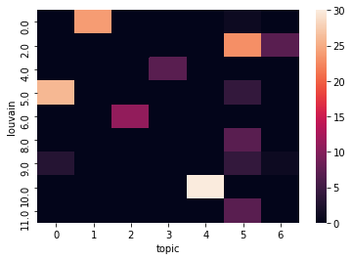
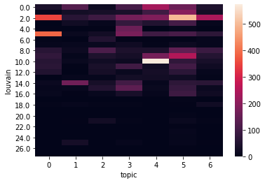
Cores Heatmap
Thanks to the heatmap we are able to select only the most relevant documents given the intersection between the topic cores and communities core.
Heatmap communities and topics
Intersection cores communities and topics

Slide 36
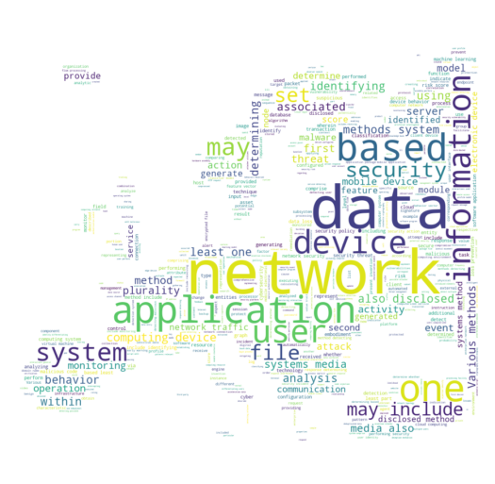
Network Security
4. Final Evaluation
User Authentication
Image - Video

Slide 37
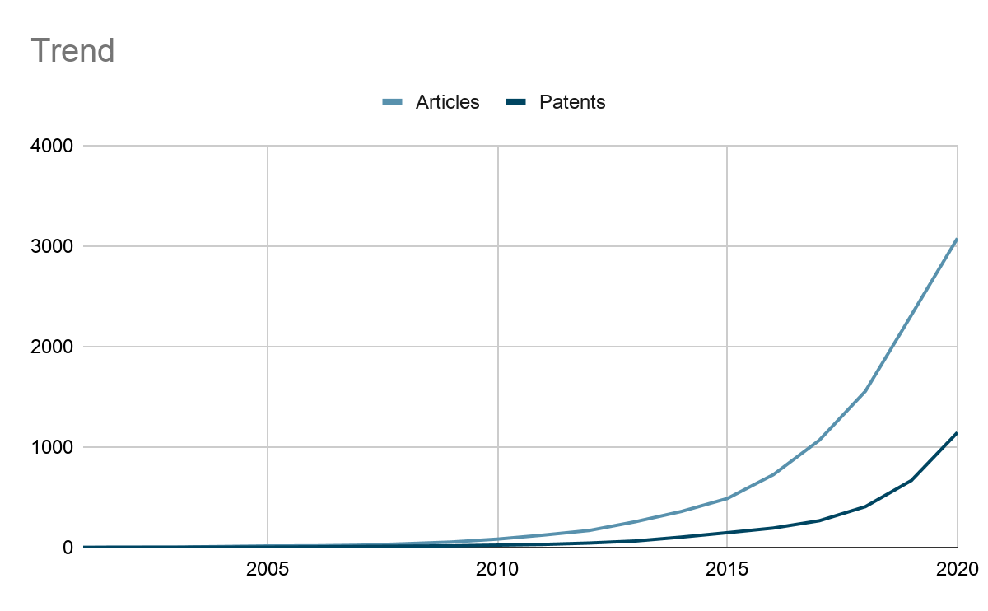
Network Security
Technologies
Cloud based security monitoring using unsupervised pattern recognition and deep learning, predicting behavioral analysis for malware detection. (US20190068627A1)
Method, system and equipment for deducing malicious code rules based on deep learning method (CN105975857A)
Profiling cyber threats detected in a target environment and automatically generating one or more rule bases for an expert system usable to profile cyber threats detected in a target environment
(US20150163242A1)
Identification of computerized bots and automated cyber-attack modules
(US20160306974A1)
Maturity: Growing

Slide 38
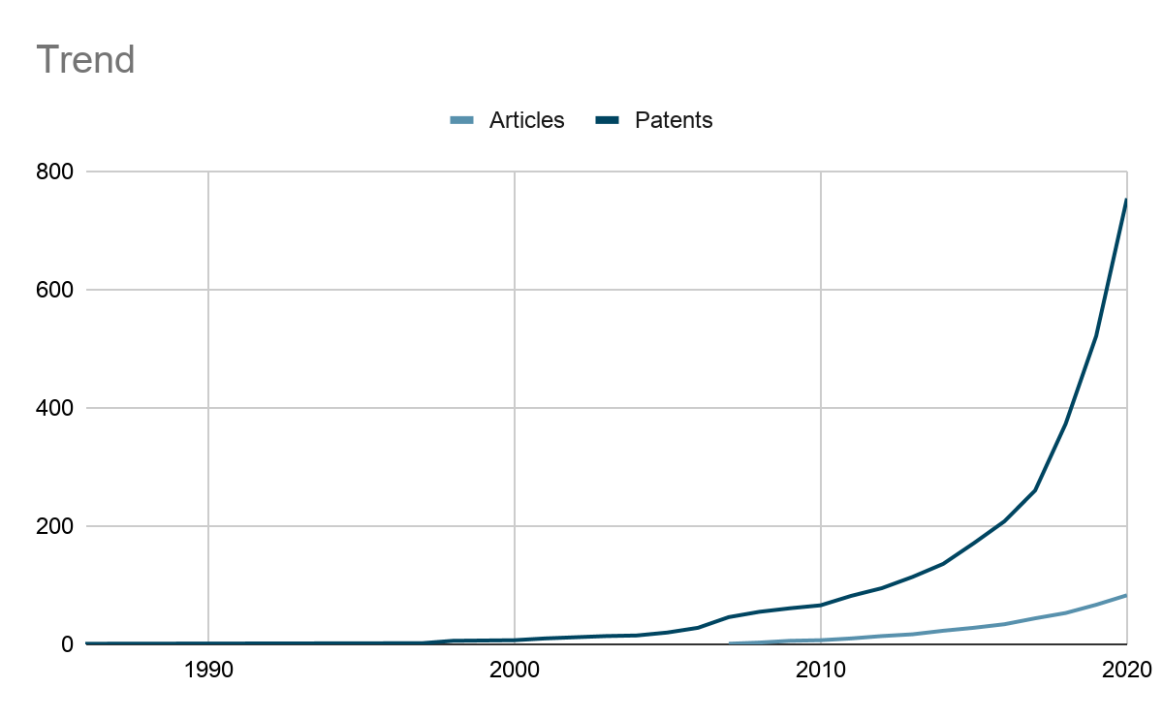
User Authentication
Technologies
System, device, and method of visual login and stochastic cryptography (US10032010B2)
Systems and methods for enabling biometric authentication options (US9569605B1)
Device, system, and method of three-dimensional spatial user authentication (US20160300054A1)
Systems and methods for detecting security threats based on user profiles (US9401925B1)
Maturity: Emerging/Growing

Slide 39

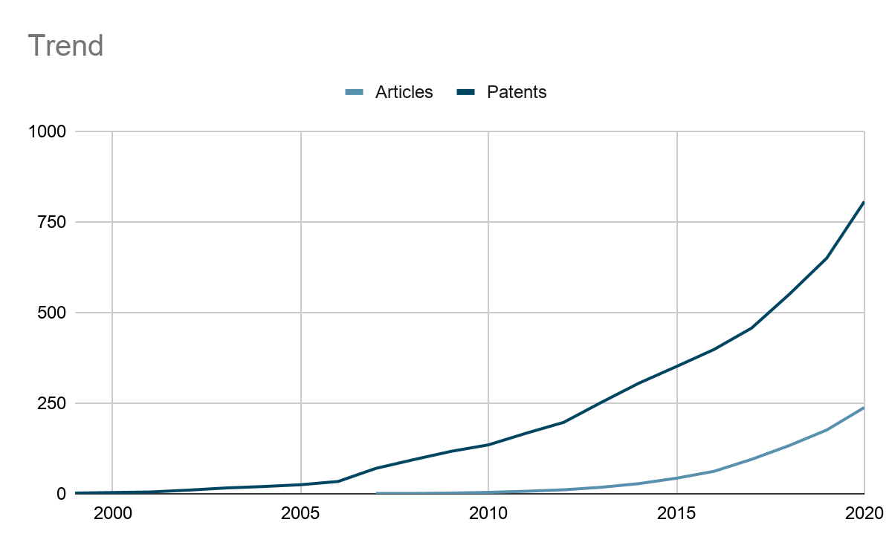
Image - Video
Technologies
Image Recognition
Hologram Reproducing and Recording
Face Identification
Maturity: Emerging

Slide 40
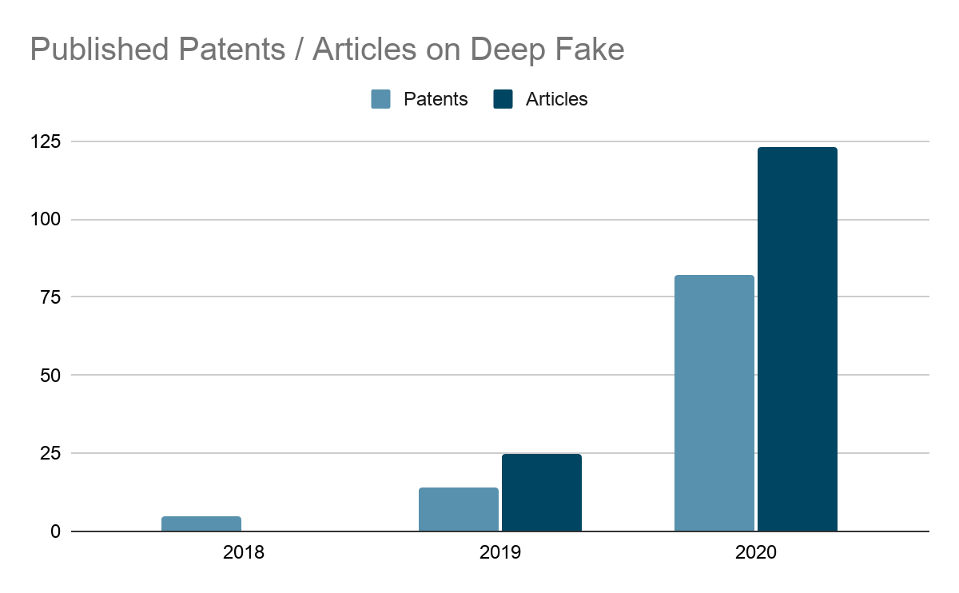
Deep Fake - Fake News
Strengths:
Threat:
Unlimited
Inexpensive
Easily accessible
Misinformation
Political and Social Instability
Recognition Technologies:
Deep Learning,
Convolutional Neural Networks,
Image Recognition and
Face Identification

Slide 41

Thank you for your attention!

